Slide 1

Carthago Display
Sprint Review #2

Slide 2
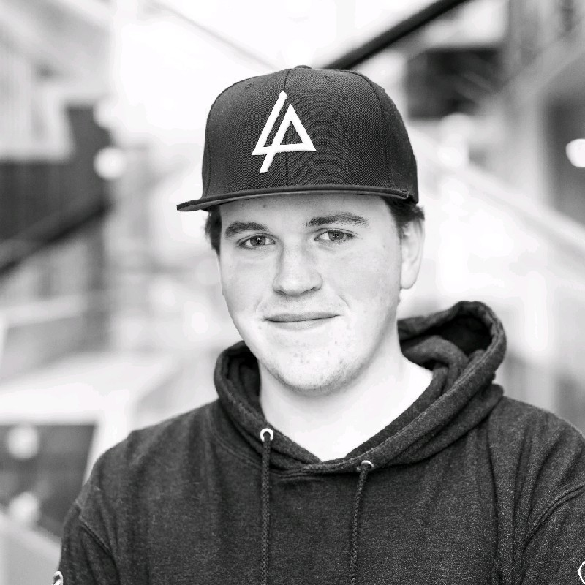
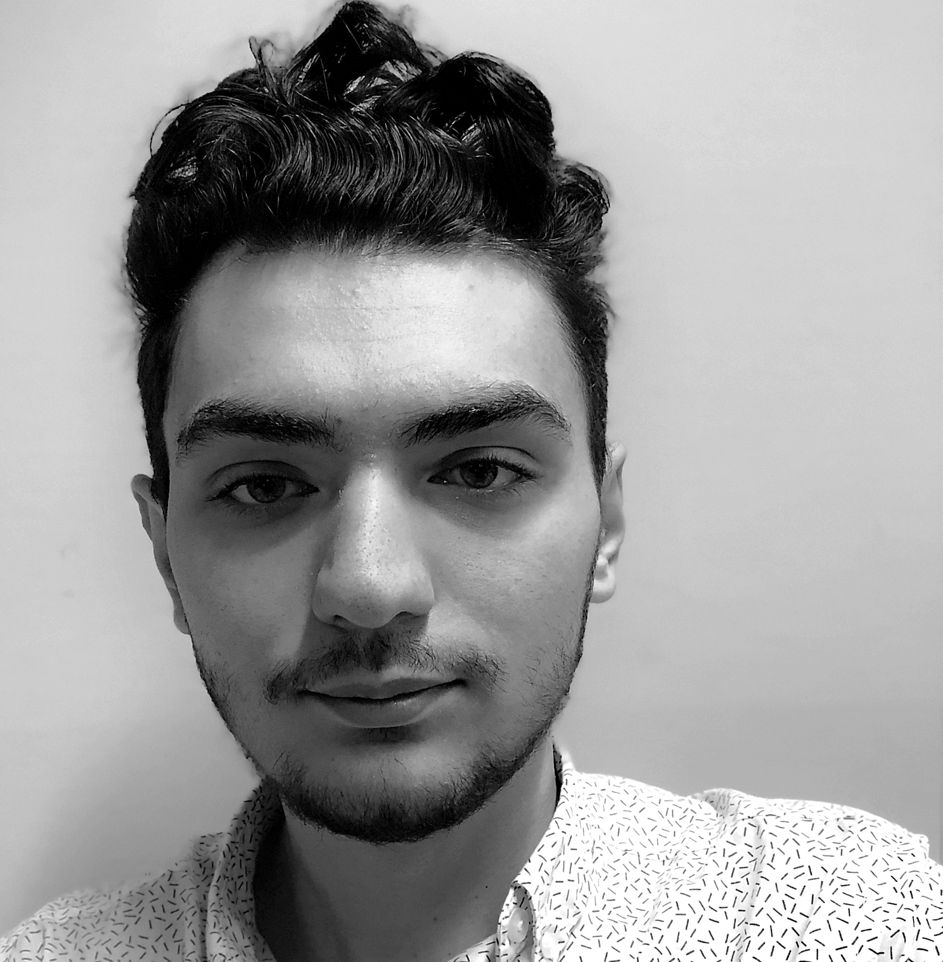
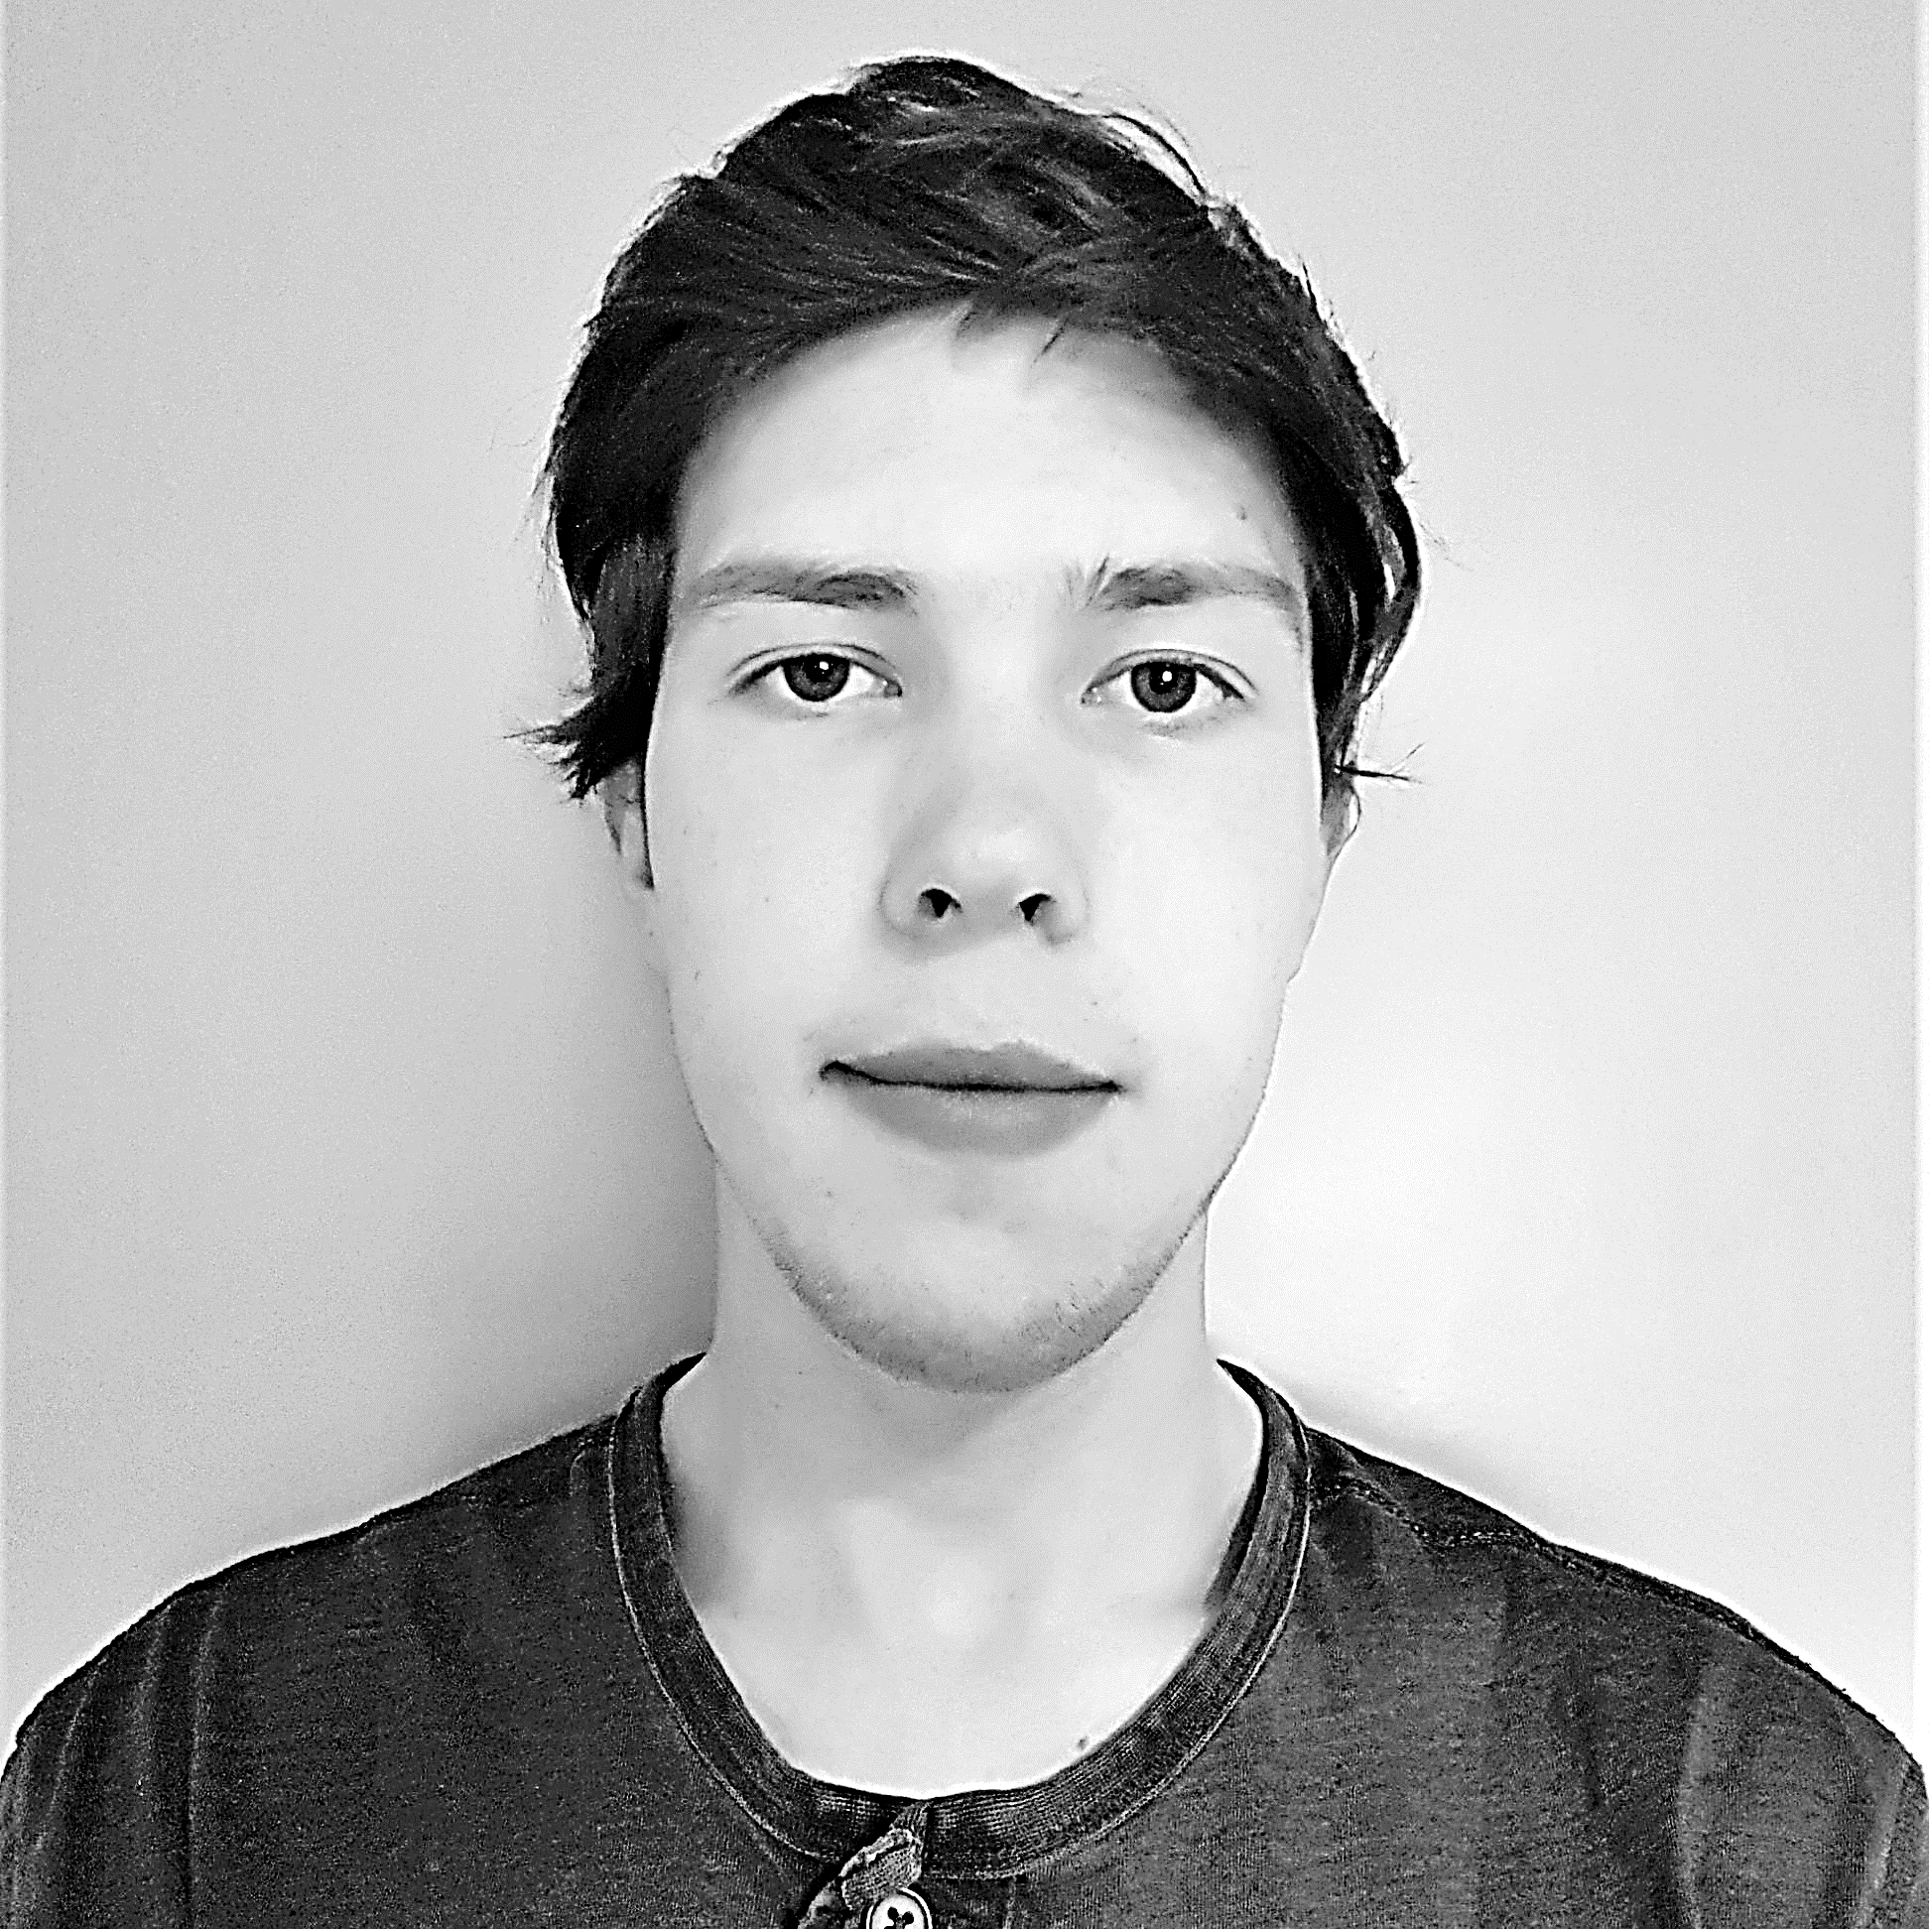
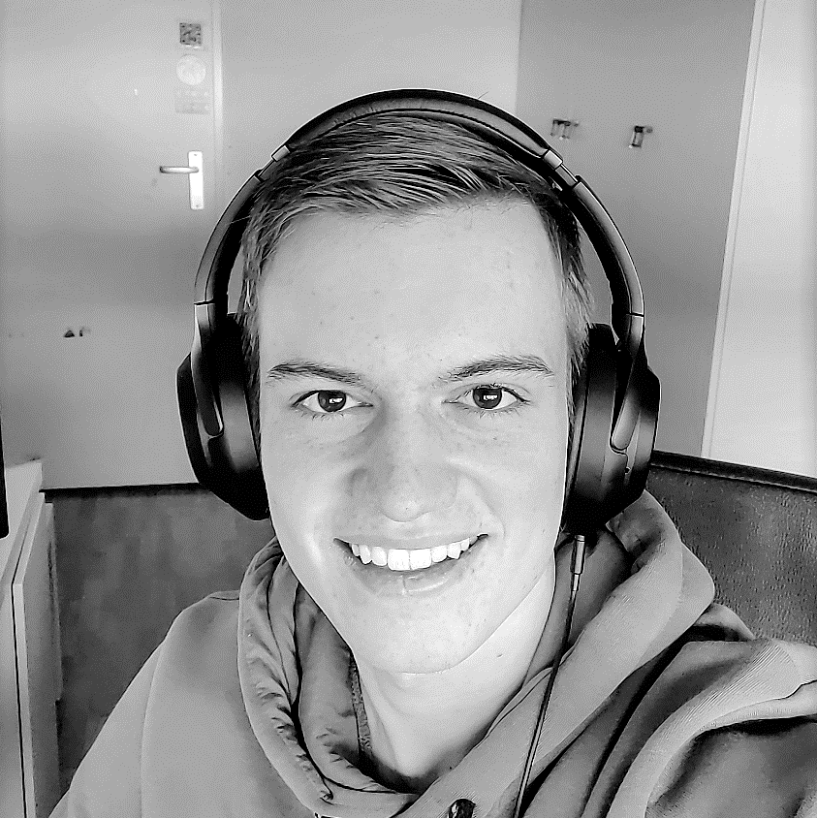
Team: EH12V.Sb #2
Syon Foppen
Full stack developer
Erel Cetin
Front end developer
Emanuel de Jong
Back-end developer
SCRUM MASTER
Kali van den Heuvel
Full stack developer

Slide 3
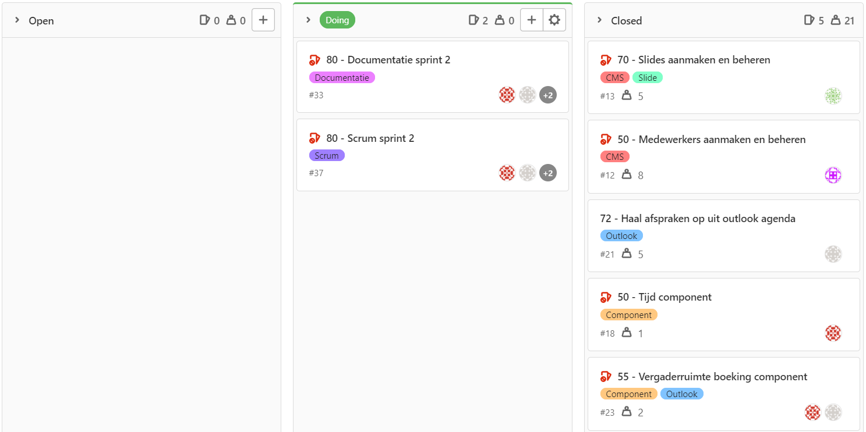
User Stories: Sprint #2

Slide 4
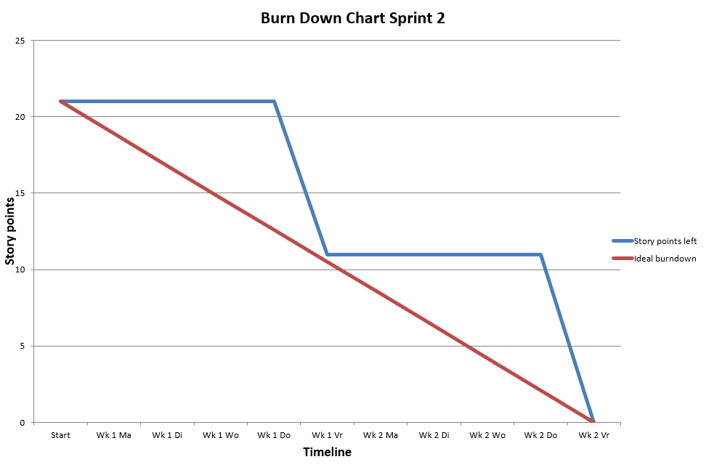

Burn Down Chart: Sprint #2
38 scrum points burned.
37 issues in productbacklog.

Slide 5
DEMO

Slide 6

Vragen?

